Slide 1
Bartow County Model Aviation
Bartow County Model Aviation
Building Value in the Community, Local Economy and Family

Slide 2
Purpose
Bartow County Model Aviation is seeking property for lease that can accommodate our club of 60 to 100 members that would be used to :
Promote the building, safe flying, and instructional and competitive activities of model aircraft in the Bartow County area.
Provide and maintain a site or sites suitable for flying radio controlled models by its members.
Provide educational and technical assistance, meeting facilities, and special equipment for use in club activities.
Promote support for other Bartow County organizations in their efforts to provide services to Bartow County citizens and to foster amicable relations between BCMA and other organizations and individuals.
Provide fellowship between BCMA members and members of other model aircraft organizations.
Purpose Background Community Impact
Field Operation Layout
Field Needs Proposal

Slide 3
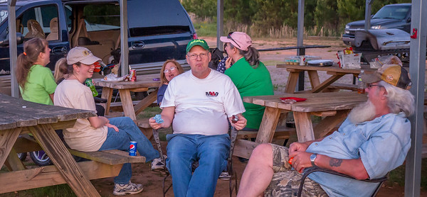
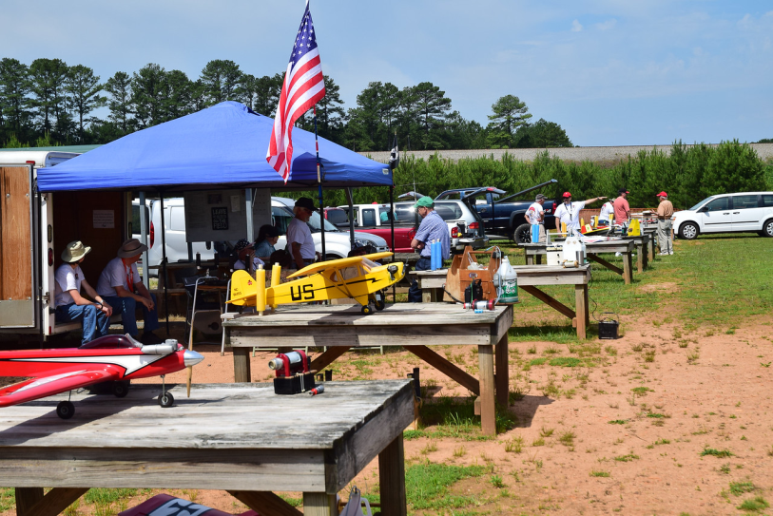
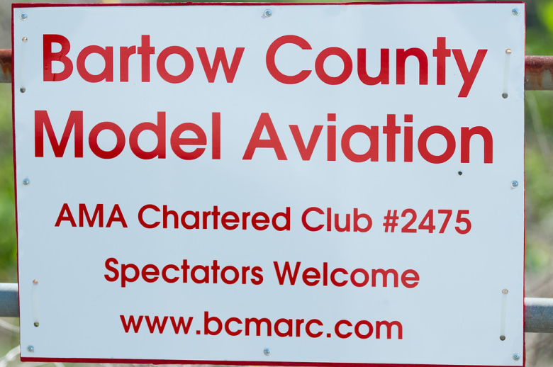
Background
30+ Years / 60+ Members
– Children thru Seniors
Current location for 5 years:
Alatoona Dam Road
Emerson, GA
Web Site: www.bcmarc.com/
Charter AMA club #2475
Academy of Model Aeronautics - Muncie IN
Official national body for model aviation in the United States
More than 2,500 model airplane clubs across the country
Membership of more than 150,000
Self-supporting - non-profit organization
Promotion and development of model aviation
Purpose Background Community Impact
Field Operation Layout
Field Needs Proposal
Education
Safety regulations
Insurance
Provides liaison with the Federal Aviation Administration, the Federal Communications Commission, and other government agencies

Slide 4
Background
Purpose Background Community Impact
Field Operation Layout
Field Needs Proposal
Our members build, fly, and maintain radio controlled and control line aircraft.
Sport aircraft
Scale aircraft
Helicopters
Sailplanes
Electric powered, “gas” powered, “glow” engine powered, un-powered
BCMA offers RC pilot instruction / training
Emphasis on SAFETY and RESPONSIBILITY
BCMA members can work with schools and other community organizations to promote aviation and spark interest in science and technology education

Slide 5
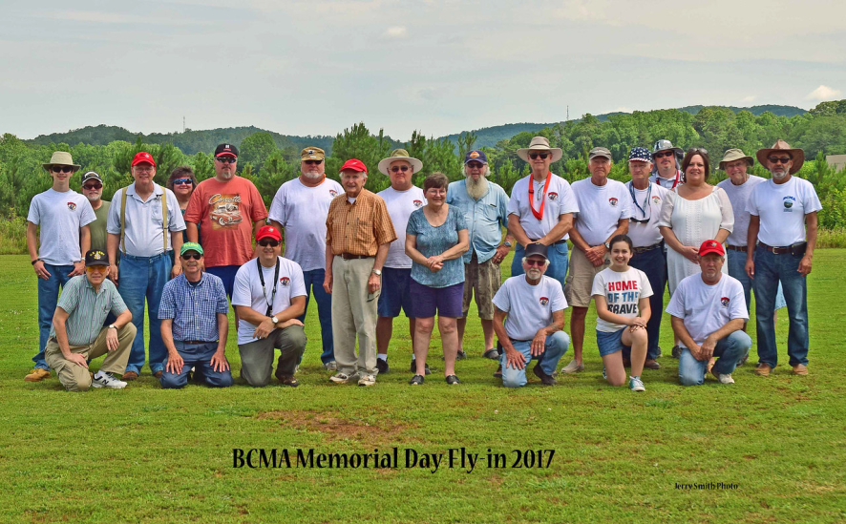
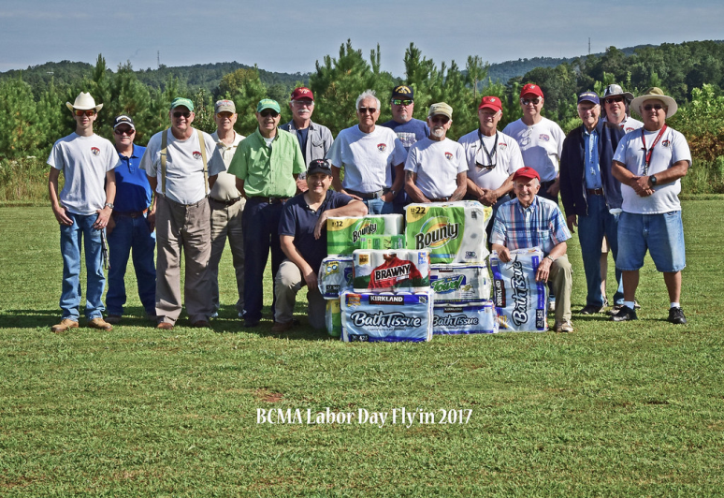
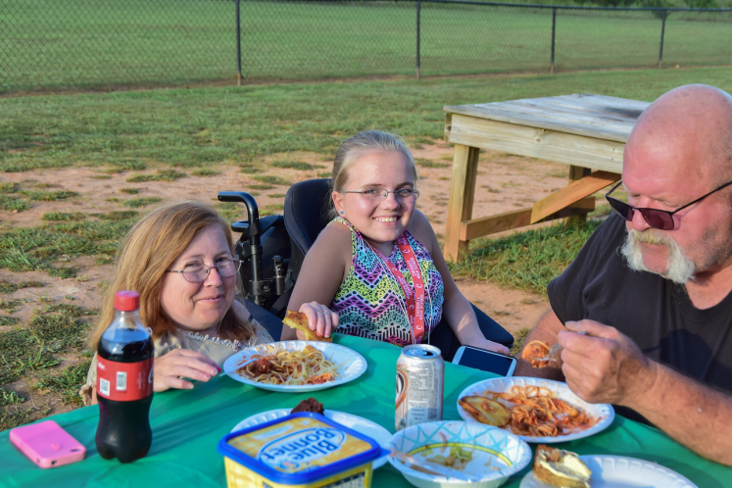
BCMA Club Events
Purpose Background Community Impact
Field Operation Layout
Field Needs Proposal

Slide 6
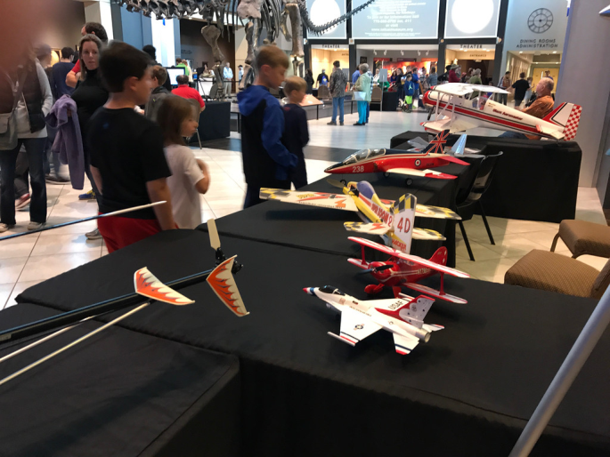
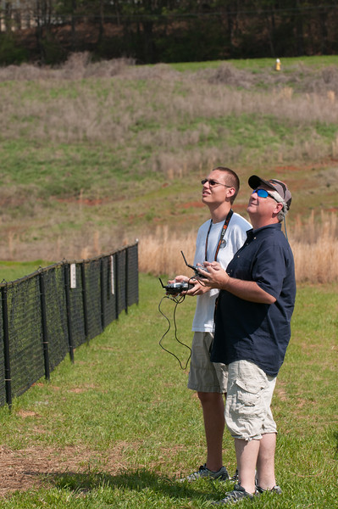
Community Outreach
Purpose Background Community Impact
Field Operation Layout
Field Needs Proposal
BARTOW Benefits from BCMA
Advocates for Children’s Charity
Shop with a Hero Children's charity
Ham Radio Weather Station
ARES Amateur Radio Support
Teach Drone Safety Class
Teach Kids to Fly
Tellus Science Museum Demonstration

Slide 7
Current BCMA Field
Purpose Background Community Impact
Field Operation Layout
Field Needs Proposal

Slide 8
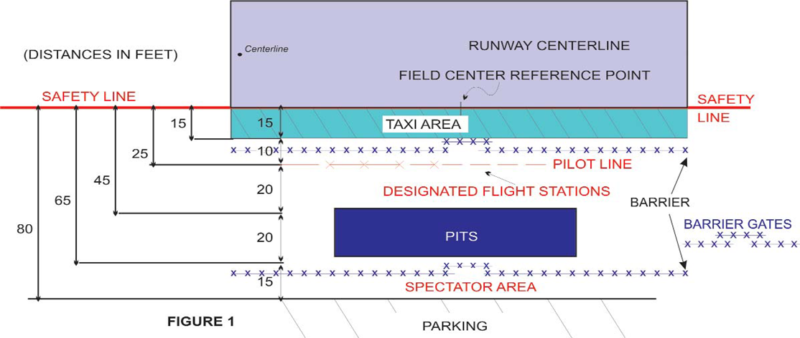
Field Operation Layout
Official AMA Safety Code is the governing factor
No landings or takeoffs from the taxi area
Barriers designed to stop taxiing models from veering into pilot or spectator positions
Pilot line set back from runway edge for safety
Public notice signs to be posted
Safety equipment
available
5 acres needed for
field operation
Purpose Background Community Impact
Field Operation Layout
Field Needs Proposal

Slide 9
Field Needs
2,000’ x 500’ Overfly Area per guidelines
Additional 250’ safety zone is desirable
Flight area clear of potential hazards
Alternate site layouts (parallel runways, cross runways, etc.) are possible.
43 acres of overfly area desired
Purpose Background Community Impact
Field Operation Layout
Field Needs
Proposal

Slide 10
Proposal
BCMA would work with the governing agency/land owner to develop a site plan, based on the available land, its size, shape, and surroundings
Purpose Background
Field Operation Layout Field Needs Community Impact Proposal
Bartow County Model Aviation would be the host club, offering site owner liability insurance through our charter from the Academy of Model Aeronautics (“AMA”).
The Site would be open to members of the Academy of Model Aeronautics, and members of local area clubs with current AMA membership
BCMA would be allowed to make site improvements at their own expense (governing proper approval)
Runway / pit area / pilot stations
Shelter (shade/wind/sun…)
Parking area
Spectator area
“Porta-Potty”
Other

Slide 11
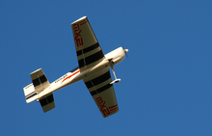
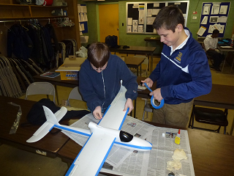
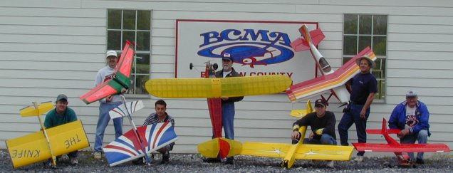
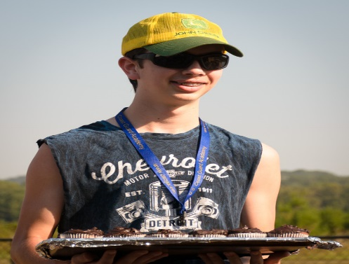
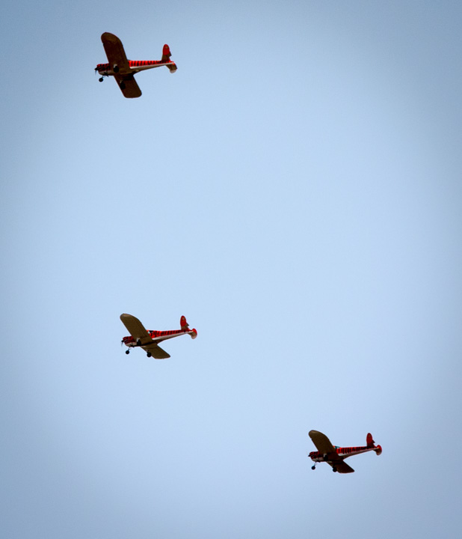
Summary
Promote Aviation - Community Outreach - Recreation and Education

Slide 12
Bartow County Model Aviation

